Slide 1

Project Title - Seasonal Agriculture Performance Analysis
Student Name – Sahana G A
College Name – New Horizon College of Engineering
AICTE STU ID : STU685e47beb510b1751009214

Slide 2

PROBLEM STATEMENT
Agricultural activities are influenced by seasonal variations in environmental conditions, farming practices, resource availability and market conditions. As a result, agricultural performance may differ from one season to another. However, raw agricultural data does not clearly explain how agricultural performance changes across seasons or what patterns can be observed in different seasonal conditions. The problem is to analyze the given agricultural dataset and investigate seasonal differences in agricultural performance by identifying meaningful patterns, trends, relationships and variations within the available data.

Slide 3
Project Description
The Seasonal Agriculture Performance Analysis project focuses on analyzing agricultural data to understand how crop performance varies across different seasons and farming conditions.
The project examines crop yield, production, environmental conditions, soil and nutrient factors, irrigation and resource usage, disease and pest risk, and economic performance to identify important patterns and relationships.
Through data cleaning, exploratory data analysis, statistical analysis, correlation analysis, comparative analysis, and data visualization, the project converts raw agricultural data into meaningful insights.
The analysis helps understand the factors associated with agricultural productivity, resource efficiency, and profitability, and provides data-driven recommendations for better agricultural planning and decision-making.

Slide 4

WHO ARE THE END USERS?
Farmers & Agricultural Producers — To understand seasonal crop performance and support better crop and resource planning.
Agricultural Planners & Consultants — To analyze productivity, environmental conditions, and farming practices for informed planning.
Agricultural Researchers & Analysts — To study seasonal patterns, relationships, and factors affecting agricultural performance.
Government & Agricultural Departments — To support data-driven agricultural policies, resource allocation, and seasonal planning.
Agribusiness & Market Stakeholders — To understand production and economic trends for better operational and market decisions.

Slide 5

Technology Used
Programming Language:
• Python
Development Environment:
• Google Colab
• Jupyter Notebook
Libraries:
• Pandas – Data manipulation and analysis
• NumPy – Numerical computations
• Matplotlib – Data visualization
• Seaborn – Statistical data visualization
• SciPy – Statistical analysis
Data Format:
• CSV Dataset

Slide 6
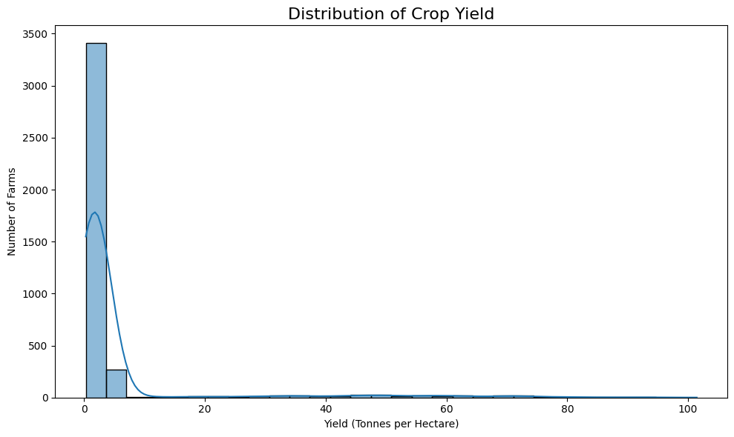
RESULTS
Distribution of Crop Yield
Crop yield shows variation across the agricultural observations in the dataset.
The distribution provides an overall view of agricultural productivity before comparing crops and seasons.

Slide 7
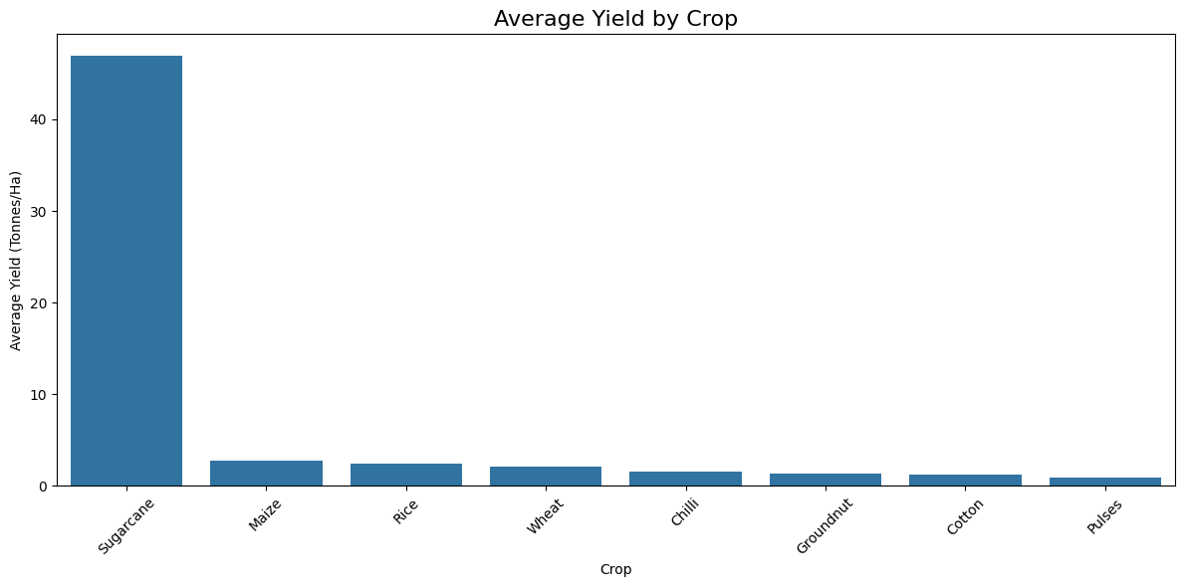
RESULTS
Average Yield by Crop
Average crop yield varies across different crops.
The comparison helps identify relatively higher- and lower-performing crops.

Slide 8
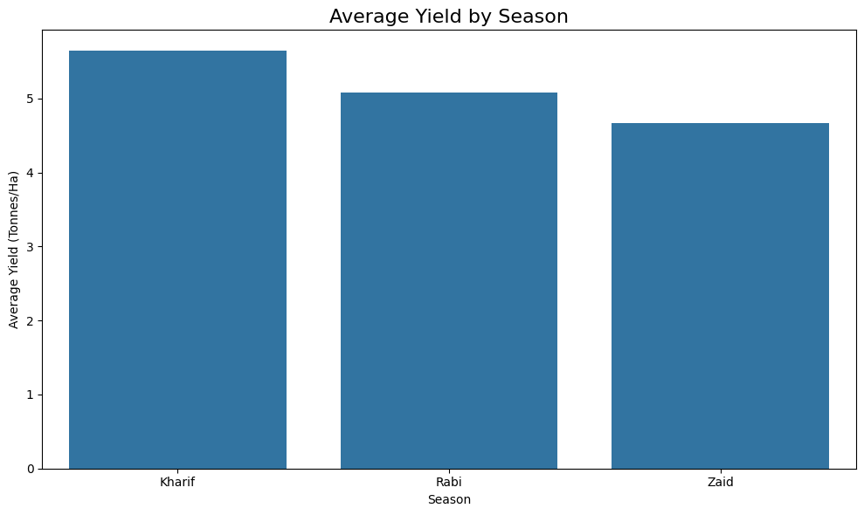
RESULTS
Average Yield by Season
Average crop yield differs across agricultural seasons.
The variation highlights the influence of seasonal conditions on agricultural performance.

Slide 9
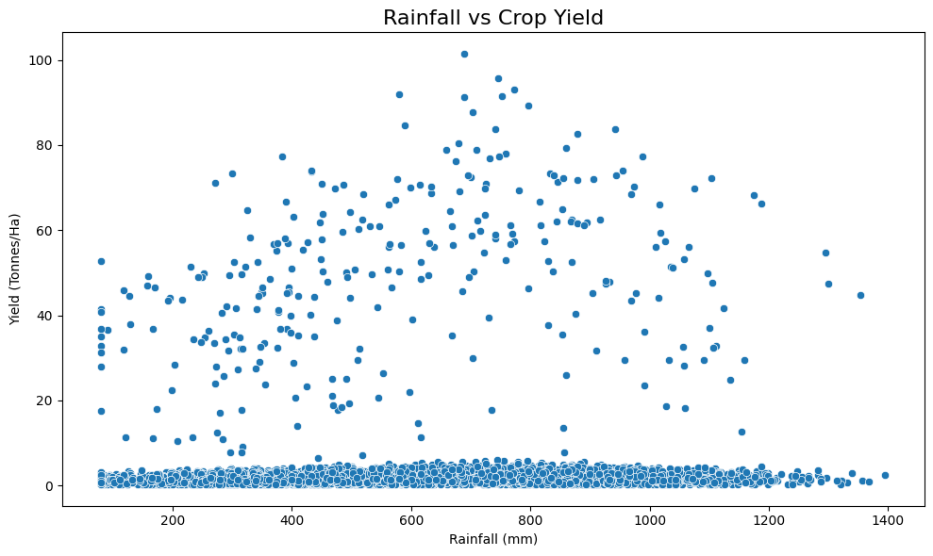
RESULTS
Rainfall vs Crop Yield
The relationship between rainfall and crop yield shows how environmental conditions are associated with agricultural productivity.
Understanding rainfall patterns can support better seasonal crop and resource planning.

Slide 10
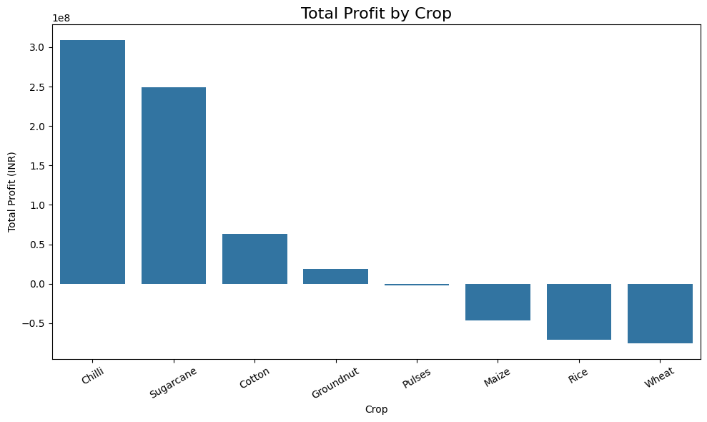
RESULTS
Total Profit by Crop
Total profit varies across different crops.
Economic performance should be considered alongside crop yield when evaluating overall agricultural performance.

Slide 11
Future scope
Real-Time Agricultural Data
Integrate real-time weather, soil and environmental data for continuous monitoring of crop performance.
Predictive Analytics
Develop machine learning models to predict crop yield based on seasonal, environmental and farming factors.
Advanced Crop Recommendations
Build a recommendation system to suggest suitable crops based on soil, climate and seasonal conditions.
Geographical Analysis
Incorporate location-based and satellite data to study agricultural performance at district and regional levels.
Interactive Dashboard
Develop an interactive Power BI or web-based dashboard for farmers, researchers and agricultural departments to explore insights dynamically.

Slide 12
GitHub Link

Slide 13
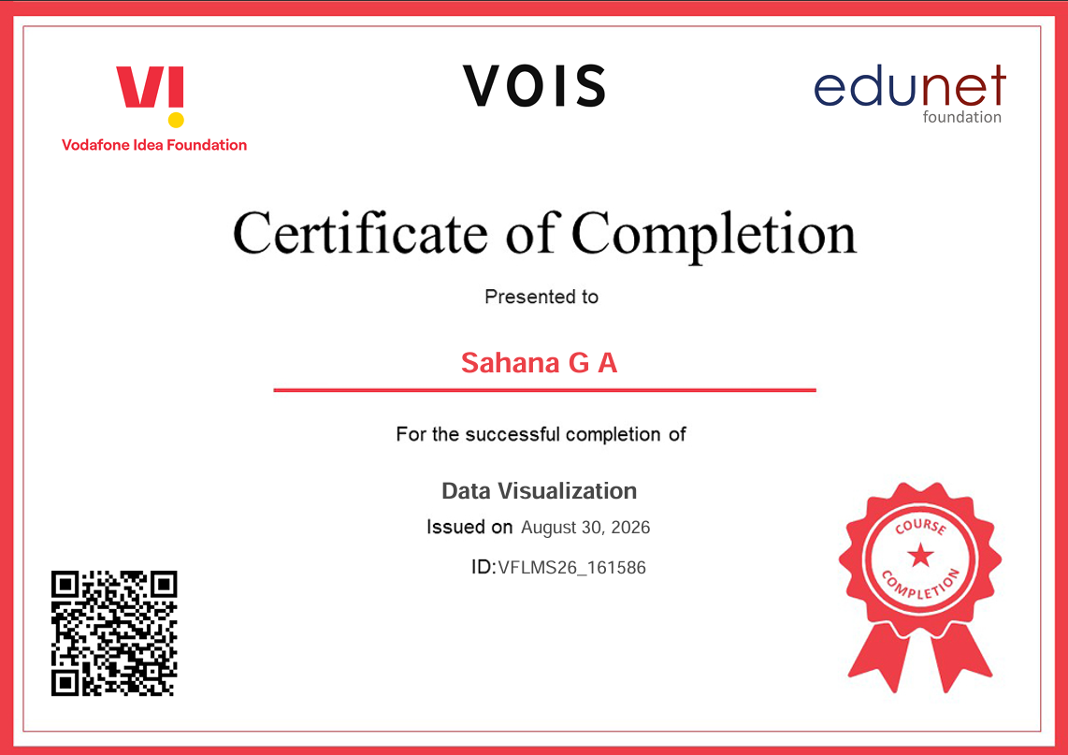
VOIS Course completion certificate - Course name- Data Visualization

Slide 14
Thank you
.
.

